Slide 1


JIS College of Engineering (An Autonomous Institution) Minor Project CSE Department Final Year
“An approach for identification using ear and face biometrics employing wavelet based image fusion and SIFT feature detection in surveillance system”
Project Group Members: Debolina Das. Akash Pal. Avinandan Sau. Sukanta Sharma.
GUIDED BY:
Madhuchhanda Dasgupta
Asst. Professor
CSE Dept

Slide 2
Introduction
Biometrics refers to methods for uniquely recognizing humans based upon one or more intrinsic physical or behavioral traits.
In information technology, in particular, biometrics is used as a form of identity access management and access control.
It is also used to identify individuals in groups that are under surveillance.

Slide 3
Biometric characteristics :
Active
Passive

Slide 4
Active Biometric characteristics
Fingerprint recognition
Iris recognition
Retina recognition
Face recognition
Ear recognition

Slide 5
Passive Biometric Characteristics
Voice recognition
Signature recognition

Slide 6
Biometric System:
Unimodal Biometric System: .
only one biometric sample is used to recognize a person
Multimodal Biometric System.:
uses two or more biometric samples from the same
person in order to identify the person

Slide 7
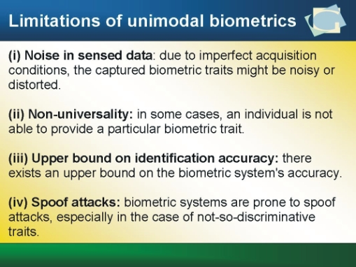

Slide 8
Multimodal Biometric System.
It is logical to try and combine multiple biometric samples to get the best results.
Some of the problems inherent in unimodal biometric systems can be overcome by using multiple sources of information.
Such systems are knows as multimodal biometric system, which uses two or more biometric samples from the same person in order to identify the person.

Slide 9
Advantages of Biometric
The person is the key so you need never remember your card or key again.
Each body part is unique and Biometrics uses your unique identity to enable a purchase activate something or unlock something.
Biometrics encompasses Voice, Vein, Eye, Fingerprint, Facial recognition and more
Logical access control e.g.: biometric signature.
Financial Security
Airports

Slide 10
Disadvantages
The Disadvantages are numerous however:
Criminals have been known to remove fingers to open biometric locks, Biometrics requires a lot of data to be kept on a person, these systems are not always reliable as human beings change over time if you are ill; eyes puffy, voice hoarse or your fingers are rough from laboring for example it maybe more difficult for the machinery to identify you accurately.
Every time you use Biometrics you are being tracked by a database bringing up a range of privacy issues.
The final disadvantage is the expense and technical complexity of such system.

Slide 11
Need of Biometrics
Biometric does solve problems and does appeal to the modern demands.
Regardless of the fact that some of the biometrics has high initial costs they do save money on the long run to the cooperation and institutes that choose to adopt them.
It is easy to use and offers almost immediate authentication without several steps.
Biometric devices can be used in hospitals to identify emergency patients who may not be in a position to communicate.

Slide 12
SIFT (Scale Invariant FEATURE TRANSFORM)
Scale-space extrema detection
Keypoint localization
Orientation assignment
Keypoint descriptor

Slide 13
Scale space extrema detection
done by constructing a set of progressively Gaussian blurred images with increasing values of sigma
the difference between pairs of Gaussian is taken to obtain a Difference of Gaussian (DOG) which is similar to the function Laplacian of Gaussian (LOG) to obtain potential locations for finding features.
image is then sub-sampled (i.e. 1/4th resolution of lower octave) to obtain the next octave and the same process is repeated to obtain DOG pyramid.

Slide 14
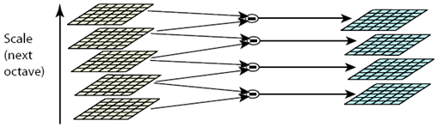
Operations within same octaves (same scale)

Slide 15
Keypoint localization
Accurately locates the feature key points by comparing a pixel (X) with 26 pixels in current scale and adjacent scales (Green Circles)
The pixel (X) is selected if it is larger/smaller than all 26 pixels.
There are still a lot of points; some of them are not good enough. The locations of keypoints may be not accurate
. Eliminating edge points, keypoints are selected from the extrema based on measures of their stability
Operations between different octaves (different scale)

Slide 16
Orientation assignment
Assigns orientation to each keypoint
An orientation histogram is formed from the gradient orientations of sample points within a region around the keypoint.
Peaks in the orientation histogram correspond to dominant directions of local gradients.
The highest peak in the histogram is detected, and then any other local peak that is within 80% of the highest peak is used to also create a keypoint with that orientation.

Slide 17
Keypoint descriptor
This step describes the key point as a high dimensional vector.
The local image gradients are measured at the selected scale in the region around each keypoint.
It computes relative orientation and magnitude in a 16x16 neighborhood around each key point.
It forms weighted histogram (8 bin) for 4x4 regions. Finally it concatenates 16 histograms in one long vector of 128 dimensions.

Slide 18
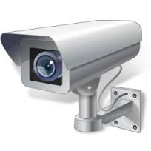
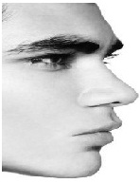

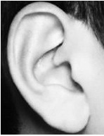
Acquisition & Extraction

Slide 19

Image Fusion & Feature Extraction
Extracted Features
Fused Image

Slide 20
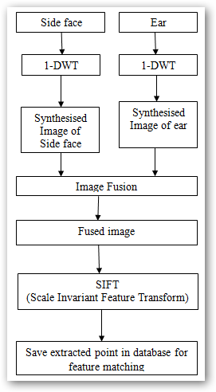
FLOWCHART

Slide 21
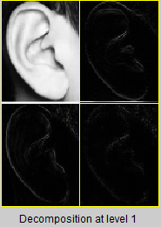

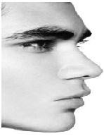
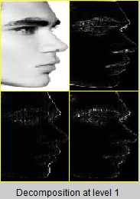
Synthesised image of ear | Synthesised image of side face

Slide 22
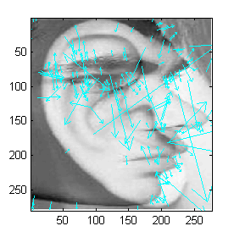
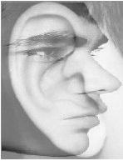
Fused Image of ear and side face
Extracted features using SIFT

Slide 23
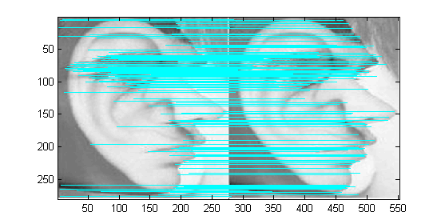
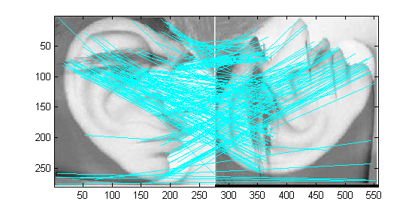
Matching
Image rotated by 90 degree
Normal matching

Slide 24
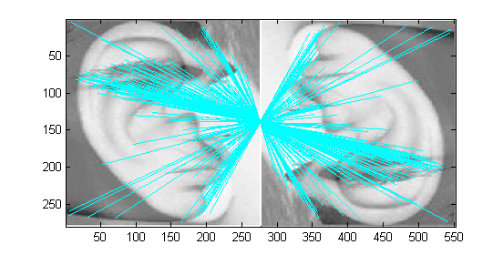
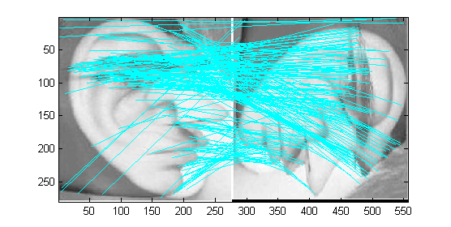
MORE MATCHING
Image rotated by 270 degree
Image rotated by 180 degree

Slide 25
RESULTS OF MATCHING
Number of key points found in the fused image is 206
Image Transformation | Match found
0 degree | 206
90 degree | 189
180 degree | 187
270 degree | 190

Slide 26
FUTURE SCOPE
Future work would involve in establishing a database of side face-ear including plotting the ROC Receiver Operating Characteristic (ROC) which would project the comparison of true vs. false positive rate, at various threshold settings.
Accuracy can also be measured in terms of Area under the ROC Curve (AUC).

Slide 27
REFERENCE
A.K.Jain and A. Ross, “Multibiometric systems”, Communications of the ACM, vol. 47, no.1, pp. 34 - 40,2004.
Dakshina Ranjan Kisku, Jamuna Kanta Sing, MassimoTistarelli, Phalguni Gupta,” Multisensor Biometric Evidence Fusion for Person Authentication using Wavelet Decomposition and Monotonic-Decreasing Graph”, 2009 Seventh International Conference on Advances in Pattern Recognition, 2009 IEEE.
Nilanjan Dey, Subhendu Das, Pranati Rakshit, “A Novel Approach of Obtaining Features Using Wavelet Based Image Fusion and Harris Corner Detection”, International Journal of Modern Engineering Research , Vol.1, Issue.2, pp-396-399.
D. G. Lowe, “Distinctive image features from scale invariant Keypoints”, International Journal of Computer Vision, vol. 60, no. 2, 2004.
Fergus, R., Perona, P., and Zisserman, A., ”Object class recognition by unsupervised scale invariant learning”, IEEE Conference on Computer Vision and Pattern Recognition, Madison, Wisconsin, pp. 264-271, 2003.
Shekhar Karanwal, Davendra Kumar, Rohit Maurya, “Fusion of Fingerprint and Face by using DWT and SIFT”, International Journal of Computer Applications (0975 – 8887) Volume 2, No.5, June 2010.
YunhongWang, Tieniu Tan, and Anil K. Jain,” Combining Face and Iris Biometrics for Identity Verification”
Fusion of Fingerprint and Face by using DWT and SIFT, International Journal of Computer Applications (0975 – 8887) Volume 2 – No.5, June 2010

Slide 28

THANK YOU……..

